Slide 1
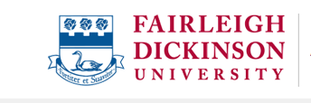
Louai Rahal, MA, MSc., LL.M., PhD
APSA Teaching and Learning Conference, 2023
The Failure to Generalize Empathy
The Failure To Generalize Empathy

Slide 2
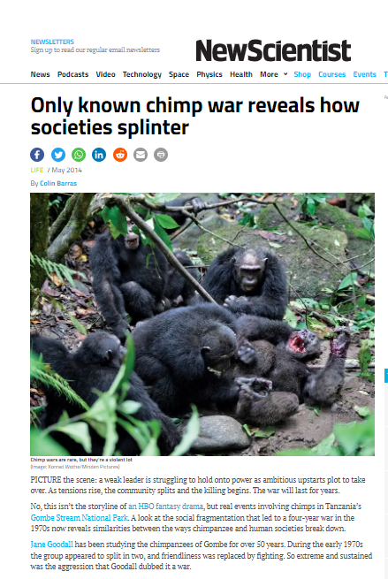
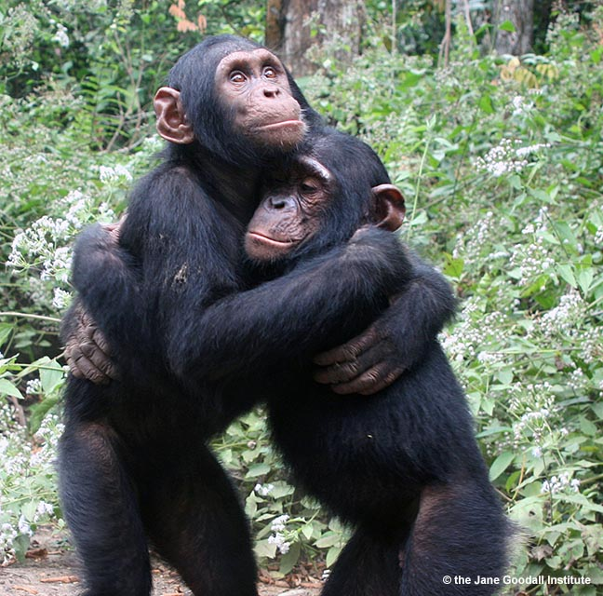
Louai Rahal, MA, MSc., LL.M., PhD
APSA Teaching and Learning Conference, 2023
The Failure to Generalize Empathy
Chimpanzees: Empathy and Violence
Image of Chimpanzee being tortured by other Chimpanzees
Within their community:
Empathy and compassion
Violence then reconciliation
With ‘outsiders’:
Torture and genocidal behaviour

Slide 3
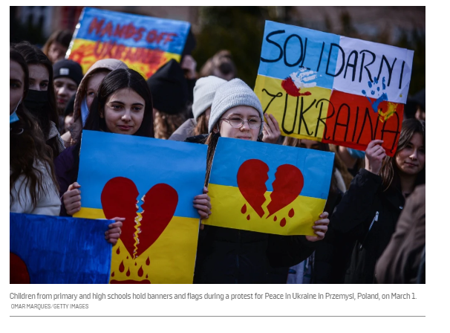
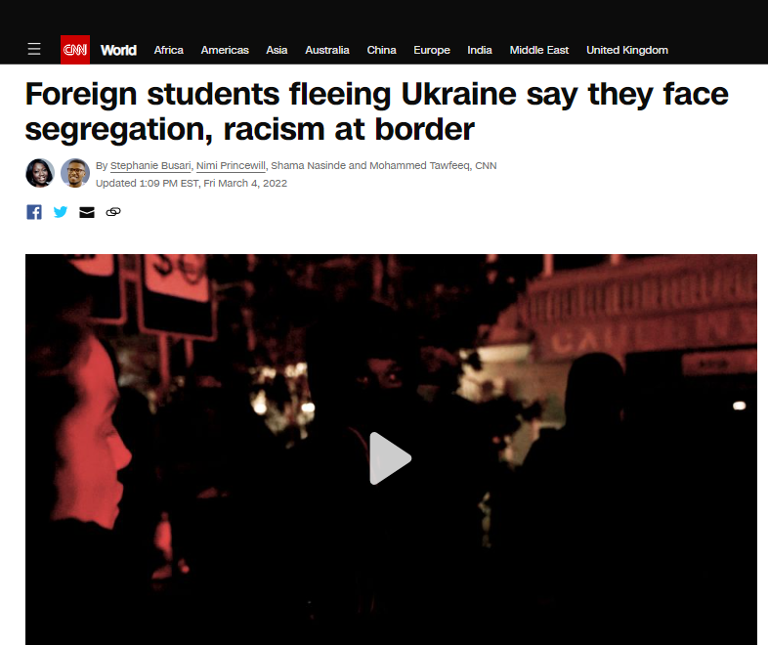
Louai Rahal, MA, MSc., LL.M., PhD
APSA Teaching and Learning Conference, 2023
The Failure to Generalize Empathy
Human Beings: Empathy, Indifference, and Violence
OMAR MARQUES/GETTY IMAGES

Slide 4
Louai Rahal, MA, MSc., LL.M., PhD
APSA Teaching and Learning Conference, 2023
The Failure to Generalize Empathy
Human Beings: Empathy, Indifference, and Violence
High levels of Empathy can coexist with high levels of violence/indifference/hatred
OMAR MARQUES/GETTY IMAGES

Slide 5
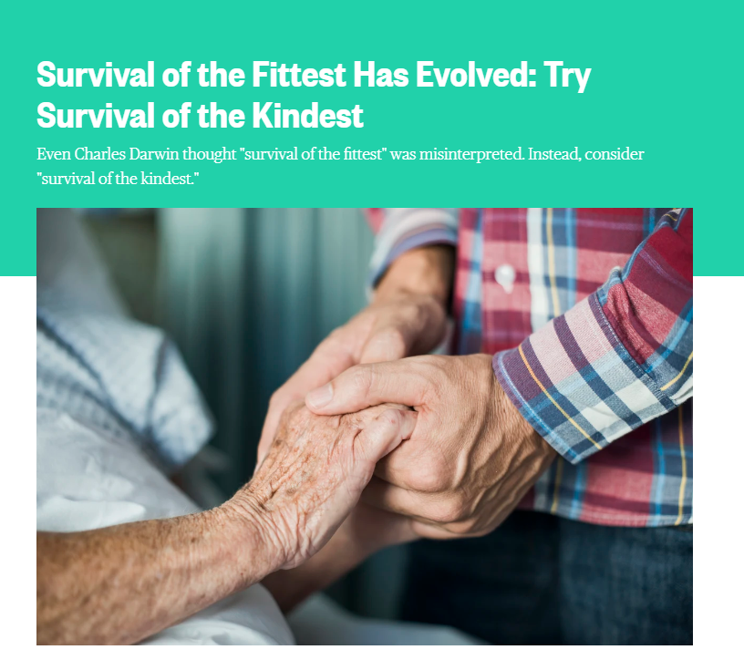
Louai Rahal, MA, MSc., LL.M., PhD
APSA Teaching and Learning Conference, 2023
The Failure to Generalize Empathy
Explaining why Humans Fail to Generalize Empathy
-Theory 1
Darwin: We have prosocial instincts (altruism, empathy)
“Survival of the kindest”
Us vs Them distinctions and misrepresentations construct others as threats and as unworthy of empathy
Portra Images / Getty Images
https://www.nbcnews.com/better/relationships/survival-fittest-has-evolved-try-survival-kindest-n730196

Slide 6
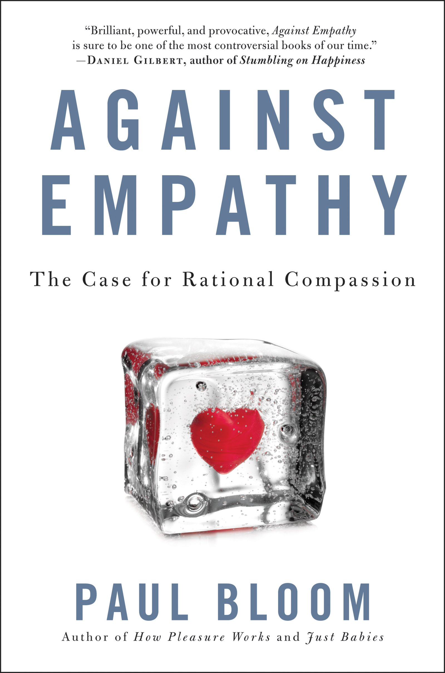
Louai Rahal, MA, MSc., LL.M., PhD
APSA Teaching and Learning Conference, 2023
The Failure to Generalize Empathy
Explaining why Humans Fail to Generalize Empathy
-Theory 2
Empathy is prone to bias
By putting the spotlight on the suffering of one individual/group, empathy turns our attention away from other individuals/groups
Focus on “rational compassion”

Slide 7
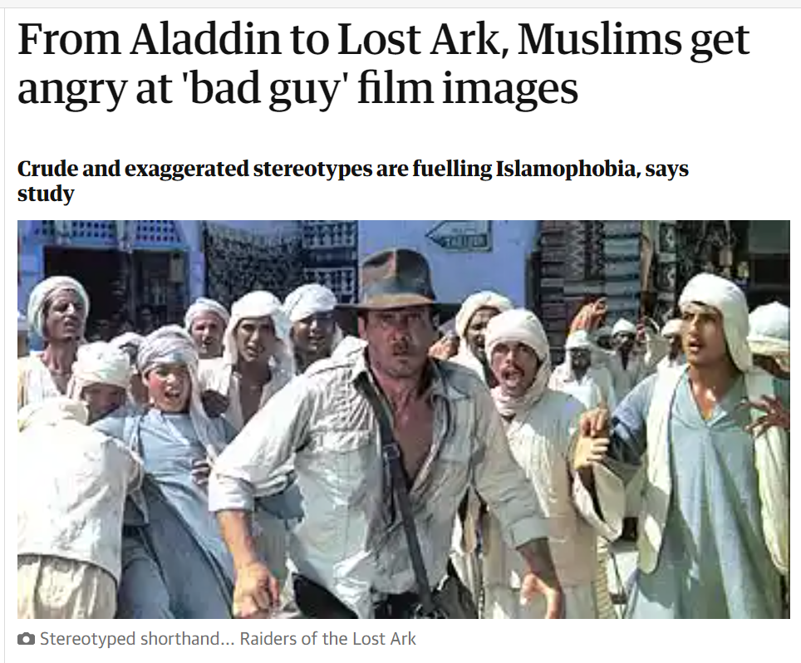
Louai Rahal, MA, MSc., LL.M., PhD
APSA Teaching and Learning Conference, 2023
The Failure to Generalize Empathy
Assignment:
Pick one theory (Theory 1 or Theory 2), summarize it and get ready to defend it in a debate.
Bring examples of misrepresentations that have dehumanized particular social groups and explain the impact of these misrepresentations based on the theory that you picked.
https://www.theguardian.com/media/2007/jan/25/broadcasting.race

