Slide 1

Incorporating Information Literacy Skills into your syllabus
Kim MacVaugh, MA, MLIS, Georgetown University
APSA TLC 2023—February 11, 2023
Notes:
Welcome!

Slide 2
Workshop Objectives
Understand the relevance of information literacy (IL) to political science education
Recognize the six frames and key knowledge practices and dispositions associated with the ACRL Framework for Information Literacy
Relate the frames to the political science discipline and curriculum
Formulate course-specific activities and lessons that will address these IL skills
Discuss ideas for incorporating IL skill-building in the classroom with peers

Slide 3
Why care about Information literacy?
A Brief Look at the Literature

Slide 4

Information Literacy is Critical to Combatting Disinformation
“[F]ocusing on how to find and evaluate information is not sufficient….[T]he banner of information literacy has to include an understanding of information systems: the architectures, infrastructures, and fundamental belief systems that shape our information environment, including the fact that these systems are social, influenced by the biases and assumptions of the humans who create and use them.”
(Fister, 2021, emphasis original)
Notes:
Fister’s pivotal article “Lizards in the Library” is concerned with the ways in which status quo information literacy instruction has failed to prevent mass mis- and dis-information. She argues that we should give more emphasis to IL skill building, especially relating to social and online media, in education curricula.

Slide 5
Integrating IL in Political Science Classes
Shannon & Shannon (2016)
Siver & Haeg (2020)
Finds that embedded librarian involvement throughout a semester-long course improved research skills and paper outcomes
Shannon & Shannon (2021)
Builds on ACRL Framework for IL and recommends instructors work with librarians in the areas of the information cycle, evaluation, searching effectively and efficiently, and integrating information
Presented at APSA TLC in 2020 about their efforts to scaffold IL skills throughout the core courses of the Political Science major at the College of Saint Benedict
Siver & Haeg (2021)
Expands on their work finding that scaffolding information literacy into the four-year undergraduate politics curriculum including methods and capstone courses has positive impact
Notes:
TBD—request out

Slide 6
Growing IL Interest in the Discipline
Harden & Harden (2020)
Thornton & Atkinson (2021)
“Instructors must actively work to advance students’ information skills—including allocating some class time—if they want to bring output from the course in line with their expectations.”
Students must slow down when exploring information to avoid cherry picking and to allow data/evidence to guide their research.
Instructors can and should teach IL skills with or without a librarian.
Faculty believe that students lack adequate IL skills but do not necessarily explicitly teach these in their courses.
Faculty who have been trained in IL are more likely to include this in their courses.
IL training should be encouraged and the development of IL skills should be emphasized throughout curriculum.
Notes:
Recent articles in PS: Political Science & Politics have addressed information literacy needs among undergraduate students and faculty.

Slide 7
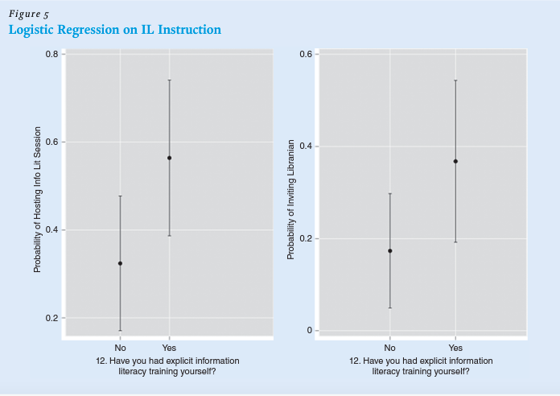
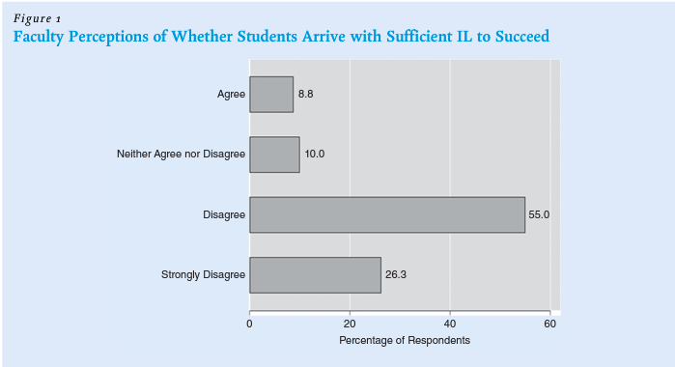
Data from Faculty Survey Conducted by Thornton and Atkinson
Thornton, S. & Atkinson, D.B. (2022, July). “Everywhere and nowhere: Information literacy in the political science classroom.” PS: Political Science & Politics 55 (3): 600–601. https://doi.org/10.1017/S1049096522000397.
Authorized use under Creative Commons 4.0 License.
Notes:
Fig 1 confirmed previous surveys reporting that faculty members do not believe students arrive on campus with sufficient IL to be successful university students. These findings, in Figure 5 suggest that when faculty members have IL training themselves, they are much more likely to ensure that their students receive it.

Slide 8
So what is Information literacy?
Overview of the ACRL Framework for Information Literacy, and the Companion Document for Politics, Policy, and International Relations

Slide 9
Decoding the Jargon
ACRL is the Association of College and Research Libraries, a division of the American Library Association (ALA) and a professional association of academic librarians and other interested individuals.
PPIRS is the Politics, Policy, and International Relations Section of ACRL, comprised of 882 members, mainly academic librarians who liaise with political science, public policy, international affairs, and law programs, faculty, and students.
Information literacy (IL), is “the set of integrated abilities encompassing the reflective discovery of information, the understanding of how information is produced and valued, and the use of information in creating new knowledge and participating ethically in communities of learning” (ACRL, 2015).

Slide 10
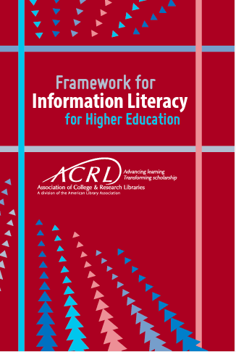
The ACRL Framework and Its Disciplinary Companion
This workshop draws heavily on the ACRL Framework for Information Literacy and PPIRS Companion Document which are both used under the Creative Commons BY-NC-SA license.
Association of College & Research Libraries (ACRL). (2015, February 9). Framework for information literacy for higher education. https://www.ala.org/acrl/standards/ilframework.
Oberlies, M., & Cloyd, B., eds. (2021, June 24). Companion document to the ACRL framework for information literacy for higher education: Politics, policy, and international relations. https://www.ala.org/acrl/sites/ala.org.acrl/files/content/standards/Framework_Companion_PPIR.pdf.
Notes:
The ACRL Framework represents a shift away from a checklist approach, you may remember an earlier iteration of ACRL’s Information Literacy Competency Standards for Higher Education (originally approved in January 2000) were rescinded in 2016 when the Framework was approved. Those competencies were sidewalked to the discipline in 2013 but we’ve recently adapted the new framework to our section’s disciplines. The framework is a complete re-visioning of student learning based on years of research and focuses heavily on knowledge practices and dispositions to cultivate.

Slide 11
The Framework for Information Literacy
Authority is Constructed and Contextual
Research as Inquiry
Scholarship as a Conversation
Information Has Value
Searching as Strategic Exploration
Information Creation as a Process

Slide 12
Authority is Constructed and Contextual
Information Resources:
reflect their creators’ expertise and credibility (constructed)
are evaluated based on need and use (contextual)
Authority in Political Science:
Is situational and conferred both formally and informally through multiple publication formats
Can be misleadingly used for political agendas; must be critically assessed
Notes:
Information resources reflect their creators’ expertise and credibility, and are evaluated based on the information need and the context in which the information will be used.
Authority is constructed in that various communities may recognize different types of authority.
It is contextual in that the information need may help to determine the level of authority required.
The authoritativeness of information in political science is situational and can be conferred through formal and informal processes and be published or broadcast in many formats.
Organizations sometimes use the legitimacy conferred upon them to misinform the public in an effort to further political agendas. It is an essential skill for researchers to think critically about biases no matter the source.

Slide 13
Information Creation as a Process
Information Resources:
are produced to convey particular messages and shared in specific formats
reflect the iterative processes of researching, creating, revising, and disseminating
Information in Political Science:
draws on an especially wide variety of primary and secondary resources including data, government documents, speeches, policy documents, scholarly research, and more
is dictated by the intentions of and constraints on the creator(s)
Notes:
Information in any format is produced to convey a message and is shared via a selected delivery method. The iterative processes of researching, creating, revising, and disseminating information vary, and the resulting product reflects these differences. Research in political science draws on a wide variety of sources, including: quantitative and qualitative data, statutes, case law, regulations, and other official documents; gray literature; products generated by news organizations; speeches and written statements; the writings of political theorists; and scholarly publications.
The intentions of and constraints on information creators dictate the content and existence of primary and secondary source material.

Slide 14
Research as Inquiry
Research:
relies on increasingly complex or new questions whose answers in turn develop additional questions or lines of inquiry in any field (iterative)
Research in Political Science:
Uses the literature to set up a question rather than draw a conclusion
is open to multiple viewpoints
formulates search strategies and chooses appropriate tools and methods for the specific information need
Notes:
Research is iterative and depends upon asking increasingly complex or new questions whose answers in turn develop additional questions or lines of inquiry in any field. Questions can help formulate search strategies to be used across different discovery tools and information types. By using the research literature to set up a question rather than draw a conclusion, students will be engaging in a form of inquiry that is open to different viewpoints.
The iterative nature of social science research requires that questions be revised as often as needed to narrow in on a particular line of inquiry and then build upon current knowledge.

Slide 15
Searching as Strategic Exploration
Searching:
is non-linear and iterative
requires the evaluation of a range of information sources and the mental flexibility to pursue alternate avenues as new understanding develops
Searching in Political Science:
takes persistence and flexibility
requires search strategies and numerous platforms including databases, the open web, data indexes, and governmental websites
Notes:
Searching for information is often nonlinear and iterative, requiring the evaluation of a range of information sources and the mental flexibility to pursue alternate avenues as new understanding develops. The varied nature of information sources requires researchers to learn multiple search strategies and navigate numerous platforms including databases, the open web, data indexes, and governmental websites.
To be successful, researchers must display persistence and flexibility in their searching which might require them to revisit their research questions due to a lack of reliable information, or generate their own datasets.

Slide 16
Information Has Value
Information is:
a commodity, a means of education, a means to influence, and a means of negotiating and understanding the world
influenced by legal and socioeconomic interests in its production and dissemination
Information in Political Science is:
selected and framed to achieve certain motivations and objectives
created by mobilizing numerous financial, human, and capital resources
produced to inform and/or influence public opinion and government policies
Notes:
Information possesses several dimensions of value, including as a commodity, as a means of education, as a means to influence, and as a means of negotiating and understanding the world.
Legal and socioeconomic interests influence information production and dissemination.

Slide 17
Scholarship as Conversation
A Scholarly Conversation is:
A community of scholars, researchers, and professionals engaged in sustained discourse developing new insights and discoveries over time as a result of varied perspectives and interpretations
A Scholarly Conversation in Political Science:
is produced in many formats beyond traditional publications
includes information creators and perspectives from governments, policymakers, think tanks, and NGOs
can be accessed by student researchers
Notes:
Communities of scholars, researchers, or professionals engage in sustained discourse with new insights and discoveries occurring over time as a result of varied perspectives and interpretations.
Research within political science is produced in many formats beyond traditional scholarly publications like books and journals.
Governments, research institutes, and intergovernmental organizations are also prolific creators of information that contribute to the scholarly conversation.
Political scholarship includes perspectives from policymakers, businesses, governments, organizations, scholars and individuals.

Slide 18
How do we teach IL Skills?
Examples of Active Learning Approaches to Information Literacy in Political Science Classes
Notes:
Adding intentional information literacy components to your existing assignments and readings is not difficult but can help reinforce these skills over multiple courses. It can be as simple as “saying the quiet part out loud”—explain why you chose certain readings/authors, or segment elements of your research projects to draw attention to the practices and dispositions that will serve students their whole lives.

Slide 19
The Framework for Information Literacy in Teaching
Authority is Constructed and Contextual
Research as Inquiry
Scholarship as a Conversation
Information Has Value
Searching as Strategic Exploration
Information Creation as a Process
Notes:
We will review each of the six frames and I will offer some ideas for both novice and advanced students as well as questions to keep in mind as you assess whether the class has developed the practices and dispositions for each concept. I will also direct you to some published lesson plans for further reading.

Slide 20
Teaching that Authority is Constructed and Contextual
Novice:
Advanced:
Assess:
Ask students about an area they are an authority on and why
From a set of readings/media, have students determine credentials of creators and decide who is expert
Have class generate evaluation criteria checklist collectively
Challenge traditional scholarly authority and debate alternatives to academic credentials
Do students articulate critical distinctions in perspectives from sources?
Can the students recognize what authority is useful for different purposes?

Slide 21
Teaching that Information Creation is a Process
Novice:
Advanced:
Assess:
Explain peer review process using your own work as example
Have students chronologically arrange sources relating to one event/topic
Ask students to translate their academic research to format for public audience
Provide examples of different information products from same author (hidden) on same topic and discuss perceived authority and audience
Can students recognize the processes by which information is produced, shared, reformatted and presented?
Do students acknowledge the effect of formats and audiences on how information is presented and used?

Slide 22
Teaching Research as Inquiry
Novice:
Introduce concept mapping as means to brainstorm research topic
Find news article on interesting topic and generate keywords to jumpstart database research
Advanced:
Consider findings from public opinion poll and locate alternate sources to corroborate data
Use annotated bibliography to refine research question before final paper
Assess:
Can students identify a variety of sources to pursue their research interests?
Do research questions improve from iterative stages of research?

Slide 23
Teaching that Searching is Strategic Exploration
Novice:
Advanced:
Assess:
Introduce library subscription databases as means to locate authoritative resources
Explain source types and their purposes for research
Help students navigate government information sources to trace legislative history
Explore repositories of data including census, public opinion, and replication datasets
Can students articulate how information is organized and where to find different information sources?
Do students use the most appropriate tools to find what they are looking for?

Slide 24
Teaching that Information Has Value
Novice:
Advanced:
Assess:
Discuss plagiarism and proper attribution using accepted style
Compare Wikipedia to reference works available at library
Talk about paywalls and how students will get information after they graduate
Reflect on searches for data and the accessibility of local government information
Can students explain why information requires citation?
Do students understand idea of information privilege and/or how some groups are excluded from certain information?

Slide 25
Teaching that Scholarship is a Conversation
Novice:
Advanced:
Assess:
Can students identify a gap or opportunity to contribute to the conversation themselves?
Do students recognize key individuals or organizations working on an issue?
Locate and present "conversation" such as a journal letter series or policy panel and discuss lack of scholarly consensus with class
Provide articles with overlapping citations and ask students to find common sources and themes
Practice citation tracing backwards from references and forward from 'cited by' tool
Follow a topic via hashtags on social media and identify thought leaders

Slide 26

Examples: Published Political Science Lesson Plans
Brown, C. (2021, October 18). Information literacy exercise – Comparative democracy. APSA Educate. https://apsanetdev.wpengine.com/resource/10-18-2021/information-literacy-exercise-comparative-democracy.
Frames: Searching as Strategic Exploration and Authority is Constructed and Contextual
Harden, M. & Harden, J.J. (2020, April). “Embedding the new information literacy framework in undergraduate political science courses: Supplemental Materials.” PS: Political Science & Politics. https://static.cambridge.org/content/id/urn:cambridge.org:id:article:S1049096519001756/resource/name/S1049096519001756sup001.pdf
Frames: Authority is Constructed and Contextual and Scholarship as Conversation

Slide 27
Workshop time!
Pick one of the six frames that you’d like to apply to your course and move to the sign.
Notes:
Set tabletop signs for six frames around the room. If nobody chooses a frame it’s ok—better to have more than one person per group.

Slide 28
Choose a Frame to Incorporate
Authority is Constructed and Contextual
Research as Inquiry
Scholarship as a Conversation
Information Has Value
Searching as Strategic Exploration
Information Creation as a Process
Notes:
Use your worksheet to contemplate one activity you could incorporate into your existing course/syllabus. After about 5 minutes, talk to your group about your ideas. We’ll regroup in 15 minutes.

Slide 29

Sample Active Learning Techniques
Think-pair-share
3-2-1 (three things learned, two interesting things, one question)
Jigsaw (topic groups disperse to form groups with one from each original)
Worksheets/Guided notes
Online scavenger hunt/search
Problem-based/Case-study
More ideas from Iowa State University’s Center for Excellence in Teaching and Learning
Notes:
Try to think of ways that you can involve students more actively in their learning.

Slide 30
References & further reading

Slide 31
Works Cited
  Association of College & Research Libraries (ACRL). (2015, February 9). Framework for Information Literacy for Higher Education. https://www.ala.org/acrl/standards/ilframework.
  Brown, C. (2021, October 18). Information literacy exercise – Comparative democracy. APSA Educate. https://apsanetdev.wpengine.com/resource/10-18-2021/information-literacy-exercise-comparative-democracy.
  Harden, M. & Harden, J.J. (2020, April). “Embedding the new information literacy framework in undergraduate political science courses.” PS: Political Science & Politics 53(2), 344–48. https://doi.org/10.1017/S1049096519001756.
  Fister, B. (2021, February 3). Lizard people in the library. Project Information Literacy. https://projectinfolit.org/pubs/provocation-series/essays/lizard-people-in-the-library.html.
  Mattson, J.L., & Oberlies, M.K. eds. (2018). Framing Information Literacy: Teaching Grounded in Theory, Pedagogy, and Practice. ACRL Publications in Librarianship. Chicago, Illinois: Association of College and Research Libraries, a division of the American Library Association.
  Nesvig, C., ed. (2022). Companion document to the ACRL framework for information literacy for higher education: Politics, policy and international relations. ACRL Libguides. https://acrl.libguides.com/PPIRS/frameworkcompanion/home.

Slide 32
More Works Cited
  Oberlies, M. (2022, June 3). Politics, policy & international relations companion document on information literacy. APSA Educate. https://educate.apsanet.org/politics-policy-international-relations-companion-document-on-information-literacy.
  Oberlies, M., & Cloyd, B., (Eds.) (2021). Companion document to the ACRL framework for information literacy for higher education: Politics, policy, and international relations. https://www.ala.org/acrl/sites/ala.org.acrl/files/content/standards/Framework_Companion_PPIR.pdf.
  Shannon, A. & Shannon, V. (2016). “Librarians in the midst: Improving student research through collaborative instruction.” Journal of Political Science Education 12(4): 457–70. https://doi.org/10.1080/15512169.2016.1157486.
  Shannon, A. & Shannon, V. (2021). “Incorporating information literacy in political science research design.” In J. Bernstein (Ed.), Teaching research methods in political science (pp. 28–42). Edward Elgar Publishing. https://doi.org/10.4337/9781839101212.00011.
  Siver, C. & Haeg C. (2021). “Incorporating and assessing methods across the political science curriculum.” In J. Bernstein (Ed.), Teaching research methods in political science (pp. 177–93). Edward Elgar Publishing. https://doi.org/10.4337/9781839101212.00022.
  Thornton, S. & Atkinson, D.B. (2022, July). “Everywhere and nowhere: Information literacy in the political science classroom.” PS: Political Science & Politics 55 (3): 597–604. https://doi.org/10.1017/S1049096522000397.

Slide 33
Thank you!
My contact details:
  Kimberly MacVaugh, SFS and Government Librarian at Georgetown University
  Kimberly.macvaugh@Georgetown.edu
  202-687-4482
  https://www.linkedin.com/in/kimberlymacvaugh

