Slide 1


Reimagining Information Literacy Skills in the Age of AI
Get Started: Let us know your experience with AI using this Menti Survey

Slide 2

Reimagining Information Literacy Skills in the Age of AI
Kimberly MacVaugh, Georgetown University

Slide 3

The Plan
  Introductions and survey
  Lay of the land
    GAI tools for research
    AI in library platforms
    Explore a tool
  Information Literacy
    Framework(s)
    Examples of information literacy activities
    Adapting your own assignment
  Discussion

Slide 4

Introductions
I am a political science and international affairs librarian at Georgetown University where I teach and support researchers. I serve on library-wide and university-wide AI working groups.
I also represent ACRL here at APSA, specifically the hundreds of members of PPIRS, our section for librarians specializing in politics, policy, and international relations.
I have written a paper that goes more in-depth on today’s topics, available on APSA Preprints: 10.33774/apsa-2025-l3vrn
Notes:
Survey Results

Slide 5

Menti Survey Results

Slide 6
Lay of the Land
“Ultimately, both our pedagogical actions and our technological commitments are political, and we need to navigate these differing impulses. We need [to] ask what our classroom, pedagogical, and scholarly values are and discover how we can center these when deciding what technologies to bring into the classroom” (Kehlenbach, 2024, 268).

Slide 7

Concerns about GAI use
  Black box LLM training; unauthorized use of material
  Inherent biases from training material
  Environmental issues with resource-intensive GAI
  Exacerbated social inequities (e.g. paid tools and policing of use)
  Privacy and data collection
  Hallucinations, misinformation, slop
  Cognitive offloading

Slide 8

GAI Research Tools
  Tools that claim to be “AI” are proliferating rapidly, most built on existing technologies and algorithmic recommendation processes
  The most familiar generative AI services include “chatbots” like ChatGPT, Gemini, and Claude which produce outputs to your prompting based on large language models
  There are other GAI tools that can create images, music, voices, video, personas, etc.
  Our focus here is on the GAI interfaces that purport to retrieve academic information and perform “research” functions

Slide 9

AI Research Tools
  Retrieval Augmented Generation (RAG) combines the language generation capabilities of an LLM (Large Language Model) with the metadata from an index or database of material
  One major limitation is the size, scope, and quality of the underlying index
  The other issue is the potential misattribution/misinterpretation of a generated summary

Slide 10
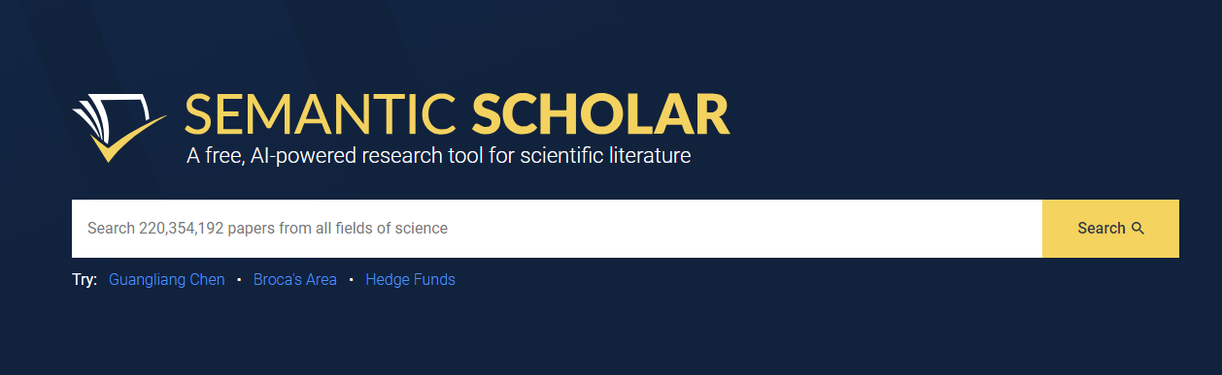
Semantic Scholar
Many GAI tools for academic research are built upon a free API that is provided by Semantic Scholar, which indexes “over 200 million academic papers sourced from publisher partnerships, data providers, and web crawls.”

Slide 11
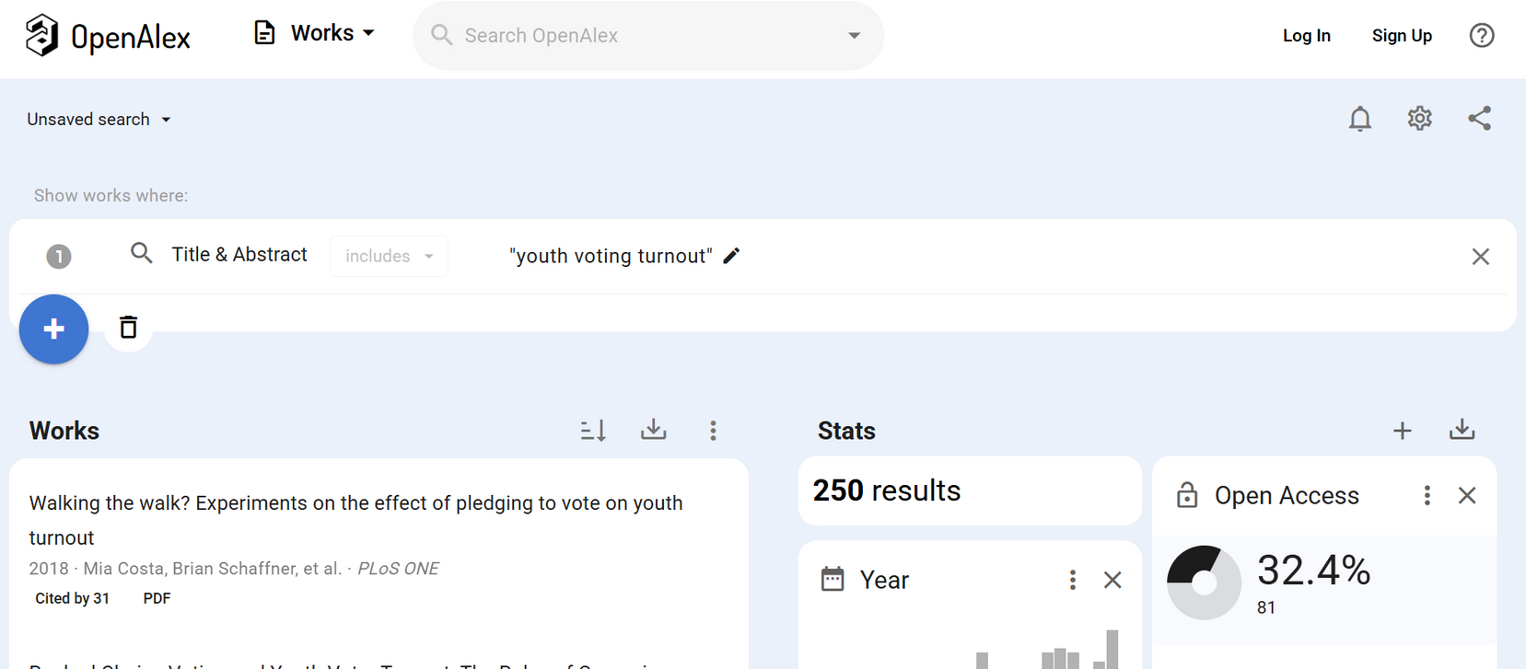
OpenAlex
OpenAlex offers an open replacement for industry-standard scientific knowledge bases like Elsevier's Scopus and Clarivate's Web of Science.

Slide 12
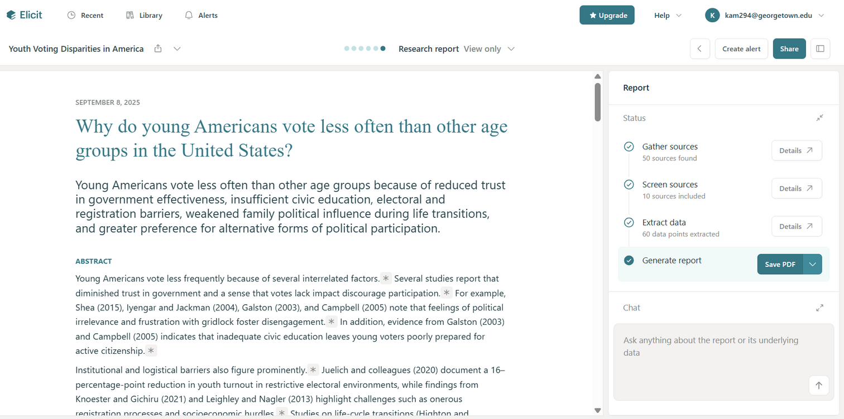
Elicit
Elicit uses Semantic Scholar to generate relevant scholarship on a natural language research question and writes research reports, literature reviews. Allows extraction of data and breakdowns by methodology, etc. Freemium.

Slide 13
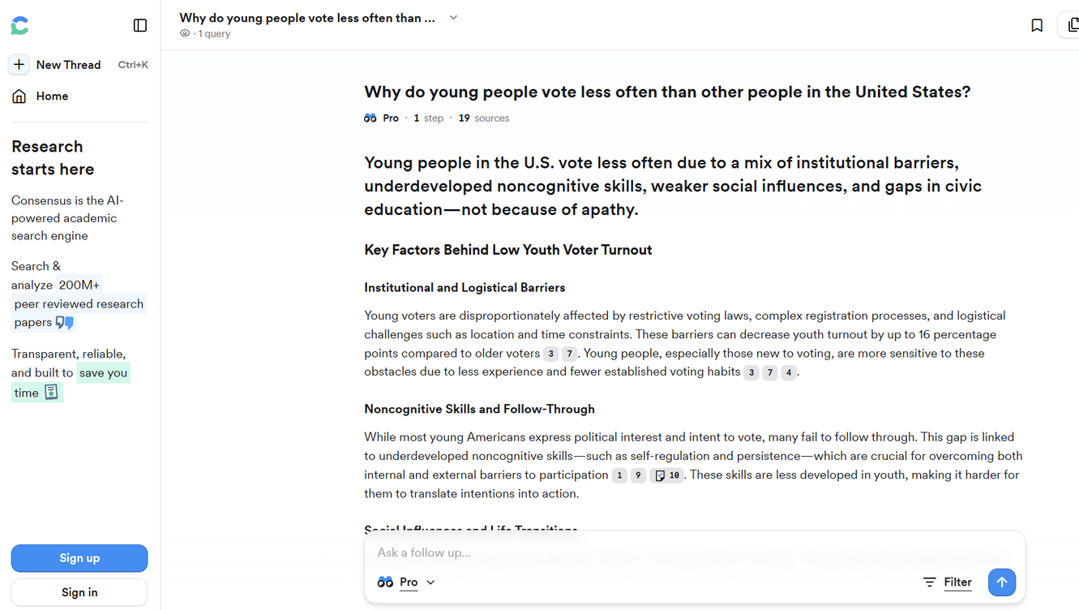
Consensus
Consensus uses Semantic Scholar to provide relevant papers for a natural language research question and rates them for various metrics, deriving a “consensus” in the literature. It also generates full reports and reviews. Freemium.

Slide 14
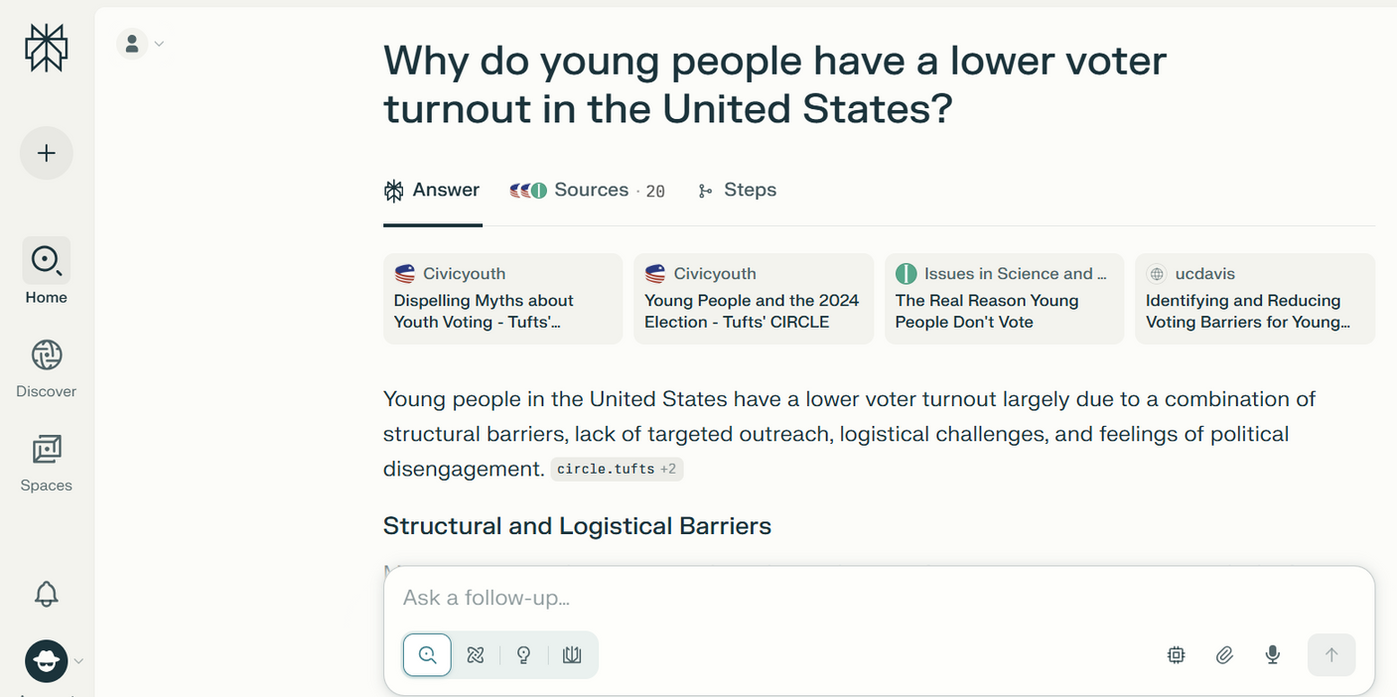
Perplexity
Perplexity is an “AI-Powered Search Engine” that uses LLMs like GPT-5 and Claude Sonnet to search the internet in real-time, gathering insights from select higher-quality sources. It then distills this into a concise summary. Freemium.

Slide 15
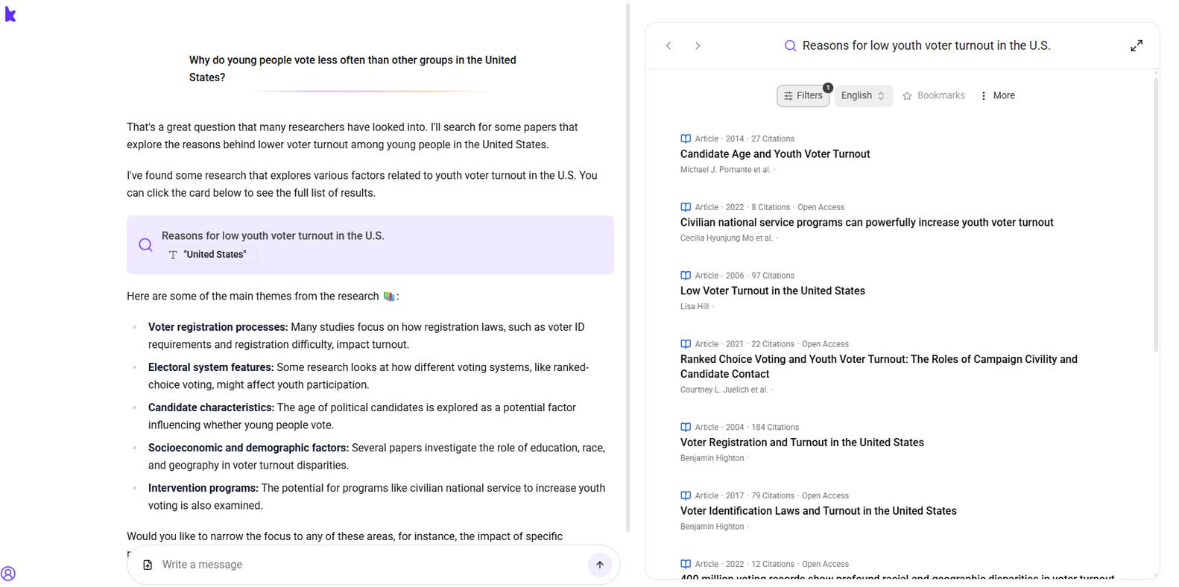
Keenious
Keenious uses OpenAlex to provide sources as well as explanations. You can highlight any text in papers and ask questions about it. You can upload papers to have them identify more similar sources. Freemium (some university subscribers).

Slide 16
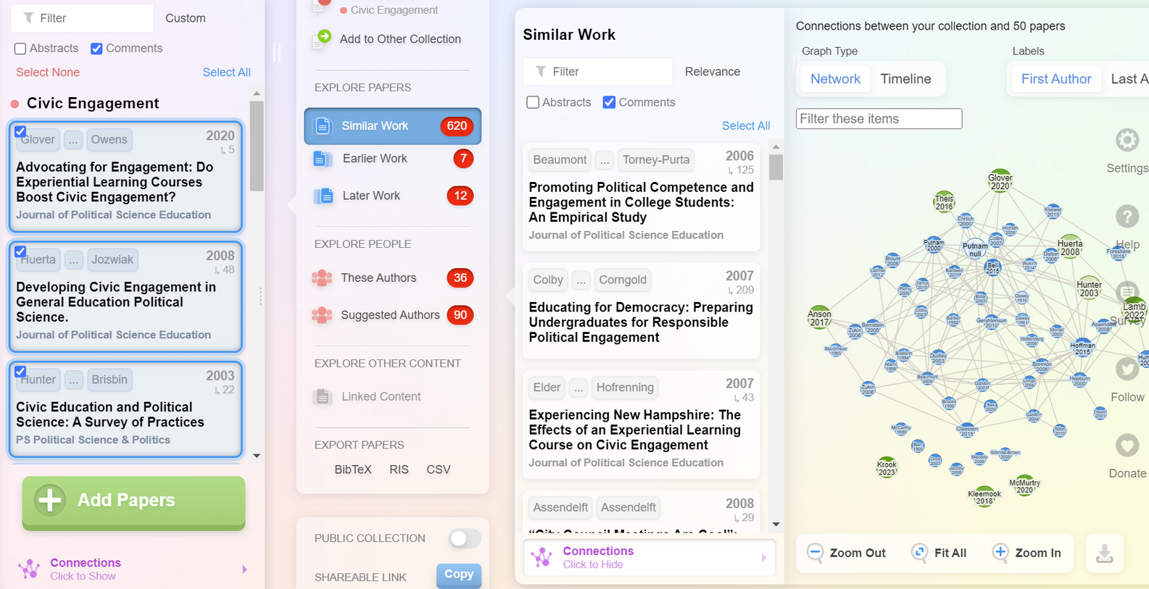
Research Rabbit
Research Rabbit is built on Semantic Scholar to identify connections and visualize networks between paper authors. “Free forever” motto.

Slide 17
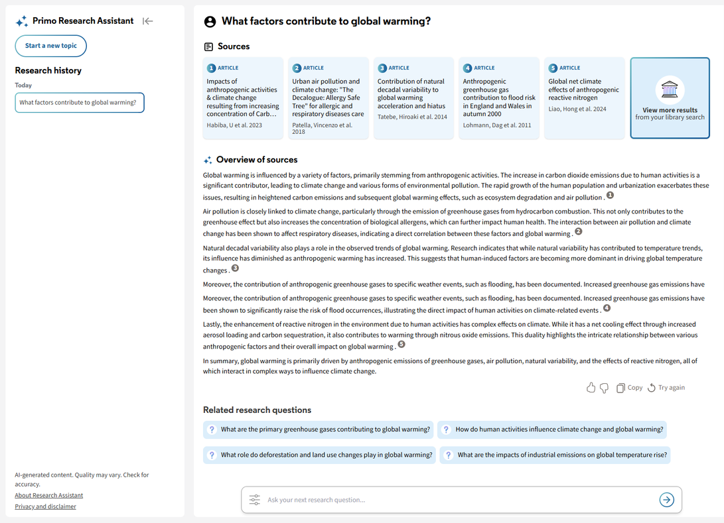
Primo Research Assistant
This is a major vendor of integated library systems. They have made their GAI platform available for free to subscribed institutions

Slide 18
Primo Research Assistant
Primo Research Assistant uses a Retrieval Augmented Generation (RAG) architecture to combine the language capabilities of the LLM (Large Language Model) with the knowledge from material indexed in the Central Discovery Index (CDI). Responses are generated as follows:
  Query Conversion – The user's question is sent to the LLM, where it is converted to a Boolean query that contains a number of variations of the query, connected with an OR. If the query is non-English, some of the variations will be in the query language, and the other variations will be in English.
  Results Retrieval – The Boolean query is sent to CDI to retrieve the results.
  Re-ranking – The top results (up to 30) are re-ranked using embeddings to identify five sources that best address the user's query.
  Overview Creation – The top five results are sent to the LLM with the instructions to create the overview with inline references, based on the abstracts.
  Response Delivery – The overview and sources are returned to the user in the response.

Slide 19





AI Widgets for Everyone

Slide 20

AI Research Assistants
  In Proquest, a “key takeaway” of the full-text document is presented first, summarizing it
  They outline “important concepts” in the document, explaining each term and why it’s relevant; users can search these terms
  “Tailored recommendations” suggest relevant research topics and prompt students with a pre-defined Boolean search that can be activated in one click.

Slide 21

Practice a Tool
Take one of your assignments, particularly one that requires academic sources, and write a basic research question in one of the discussed tools that you’ve never tried before.
  Consensus (no login needed)
  Elicit (freemium, sign up needed)
  Perplexity (no login required)
  Keenious (no login required)

Slide 22
Framework for Information Literacy for Higher Education (ACRL, 2015)
  Authority is Constructed and Contextual
  Research as Inquiry
  Scholarship as Conversation
  Information Creation as a Process
  Information Has Value
  Searching as Strategic Exploration

Slide 23

Resources for AI Information Literacy
Don’t reinvent the wheel,
talk to your librarian
Many libraries have developed guides
Vendors offer toolkits and activities
APSA scholarship includes discipline specific activities
Ex. Yale AI Information Literacy Framework
Ex. LexisNexis GenAI Curriculum
Ex. Dilling & Owen, 2025

Slide 24
Key AI Competencies
Similar to traditional information literacy, AI literacy requires scaffolding
01
Understand GAI
02
Use GAI
03
Evaluate GAI
04
Analyze GAI

Slide 25
Example 1: Mystery Author
  Provide students several anonymized documents by the same author but published in a variety of venues (your own work is great)
  Have students analyze the pieces and consider their authority, value, and bias/context
  Reveal authorship and discuss differences in genre and purpose, access, perceptions
  Compare with Keenious/Perplexity vs. Elicit/Consensus results (popular vs. academic sources)

Slide 26
Example 2: Literature Review Puzzle
  Choose a brief but well-organized literature review or portion with about 10-15 discreet sentences/citations (your work is great for this); cut them apart
  Have student groups analyze the pieces and order the cited arguments into useful/meaningful categories (i.e. reconstruct the lit review)
  Compare results with the original; discuss the scholarly conversation and the purpose of a thematic structure
  Use Elicit or Consensus to generate an AI lit review on the same research question and critique

Slide 27

Example 3: Find the Canon
  Provide students several related scholarly articles on the same narrow research topic
  Have students search the pieces to locate core authors/ citations used in two or more of the articles
  Discuss concept of “canon” and strategy of citation-tracing or mining the bibliography to research further
  Try Research Rabbit/LitMap/Connected Papers to visualize scholarly networks

Slide 28

Tactics for AI Resistance
  GAI research tools can circumvent learning of information literacy concepts by providing generated bibliographies and reports
  Activities to promote student engagement may need to occur in class
  Scaffold all research projects with peer-review and discussion
  Librarians can demonstrate efficiencies of library search tools
  Personalize the process by sharing your own scholarship and allow students to choose topics of their interest
  Require citation of sources including page numbers to increase likelihood of reading/engaging with the source beyond abstract

Slide 29

Activity
Looking at an assignment where some aspect of information literacy is your intended learning outcome, what is a way to make the project AI-resistant or to incorporate an AI tool, depending on your objective?
Brainstorm a few minutes then share with your neighbor. The back of the worksheet is available for notes.

Slide 30

Think Critically About AI Ethics
Take Responsibility
Respect Copyright
Acknowledge Use
AI tools cannot be credited with authorship nor take responsibility for their output (COPE, 2023).
AI generated content cannot be copyrighted (see Copyright.gov).
Avoid inputting copyrighted material into GAI tools.
The use of AI tools for research and/or writing should always be disclosed. Each publication has their own policies and style.

Slide 31

Conclusion
  Be sure your courses are in line with your institution and department’s AI policies.
  Set clear expectations for your students on when and how the use of GAI tools is permitted.
    They may have been given different rules by other professors.
    Some are more familiar with GAI than others.
  Consider instilling traditional information literacy skills prior to introducing AI tools.
  Ask your librarians for help!

Slide 32
Thanks for joining me today!
Contact me:
Kimberly MacVaugh
kimberly.macvaugh@georgetown.edu

Slide 33
References/Resources 1/2
ACRL. “Framework for Information Literacy for Higher Education.” Association of College & Research Libraries (ACRL), February 9, 2015. https://www.ala.org/acrl/standards/ilframework.
Ardoin, Phillip J., and William D. Hicks. “Fear and Loathing: ChatGPT in the Political Science Classroom.” PS: Political Science & Politics, April 11, 2024, 1–11. https://doi.org/10.1017/S1049096524000131.
Baer, Andrea. Investigating the “Feeling Rules” of Generative AI and Imagining Alternative Futures – In the Library with the Lead Pipe. n.d. Accessed July 18, 2025. https://www.inthelibrarywiththeleadpipe.org/2025/ai-feeling-rules/.
Dilling, Matthias, and Leah Owen. “Designing Politics and IR Assessments in the Era of AI: An Empirical Investigation into ChatGPT’s Output Across Bloom’s Revised Taxonomy.” Journal of Political Science Education 21, no. 2 (2025): 290–309. https://doi.org/10.1080/15512169.2024.2408767.
Gerlich, Michael. “AI Tools in Society: Impacts on Cognitive Offloading and the Future of Critical Thinking.” Societies (Basel, Switzerland) 15, no. 1 (2025): 6. https://doi.org/10.3390/soc15010006.

Slide 34
References/Resources 2/2
Jackson, Christopher, and Andrew Q. Philips. “Using AI to DIY? Incorporating AI-Generated Learning Tools in the Classroom”. Journal of Political Science Education, June 28, 2025, 1-19. https://doi.org/10.1080/15512169.2025.2521286.
Kehlenbach, E. Stefan. “The Impact of Infrastructure: Considerations of Generative AI in the Classroom.” Journal of Political Science Education 21, no. 2 (2025): 267–76. https://doi.org/10.1080/15512169.2024.2359439.
Lo, Leo S. AI Literacy for All: A Universal Framework [Preprint]. 2025. University of New Mexico Digital Repository.
MacVaugh, Kimberly. “Fostering Critical Thinking in the Age of AI: Why Information Literacy Still Matters.” Preprint, APSA Preprints, January 27, 2025. https://doi.org/10.33774/apsa-2025-l3vrn.
Oberlies, Mary, and Brett Cloyd, eds. “Companion Document to the ACRL Framework for Information Literacy for Higher Education: Politics, Policy, and International Relations.” ACRL, June 24, 2021. https://www.ala.org/acrl/sites/ala.org.acrl/files/content/standards/Framework_Companion_PPIR.pdf.
Spindel, Jennifer, and James Ackerman. “Adapting to the AI Era: ChatGPT in the Classroom.” Journal of Political Science Education 21, no. 2 (2025): 310–26. https://doi.org/10.1080/15512169.2024.2414017.
Wu, Nicole, and Patrick Y. Wu. “Surveying the Impact of Generative Artificial Intelligence on Political Science Education.” PS: Political Science & Politics, August 9, 2024, 1–8. https://doi.org/10.1017/S1049096524000167.

